Slide 1
Machine Learning

Slide 2
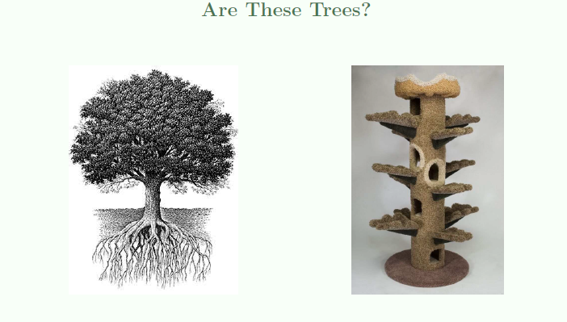
Think?
Hard to give a complete mathematical definition of a tree.
Even a 3 year old can tell a tree from a non-tree.
The 3 year old has learnt from data.

Slide 3
Machine Learning Problem
A pattern exists.
We don’t know it.
We have data to learn it

Slide 4
What is Machine Learning?
Methods that can help generalize information from the observed data so that it can be used to make better decisions in the future

Slide 5

Previous Movie Ratings Reflect Future Ratings
likes comedy?
prefers blockbusters?
likes Tom Cruise?
likes action?
viewer:
Viewer taste & movie content imply viewer rating.
Match corresponding factors then add their contributions
predicted rating
No magical formula to predict viewer rating.
movie:
Netflix has data. We can learn to identify movie “categories” as well as viewer “preferences”
blockbuster?
action content
Tom Cruise in it?
comedy content
Class Motto:
A pattern exists. We don’t know it. We have data to learn it.

Slide 6
What is ML?
Supervised learning
Given a set of features and labels learn a model that will predict a label to a new feature set
Unsupervised learning
Discover patterns in data
Active learning
Select not only model but also which examples to use

Slide 7
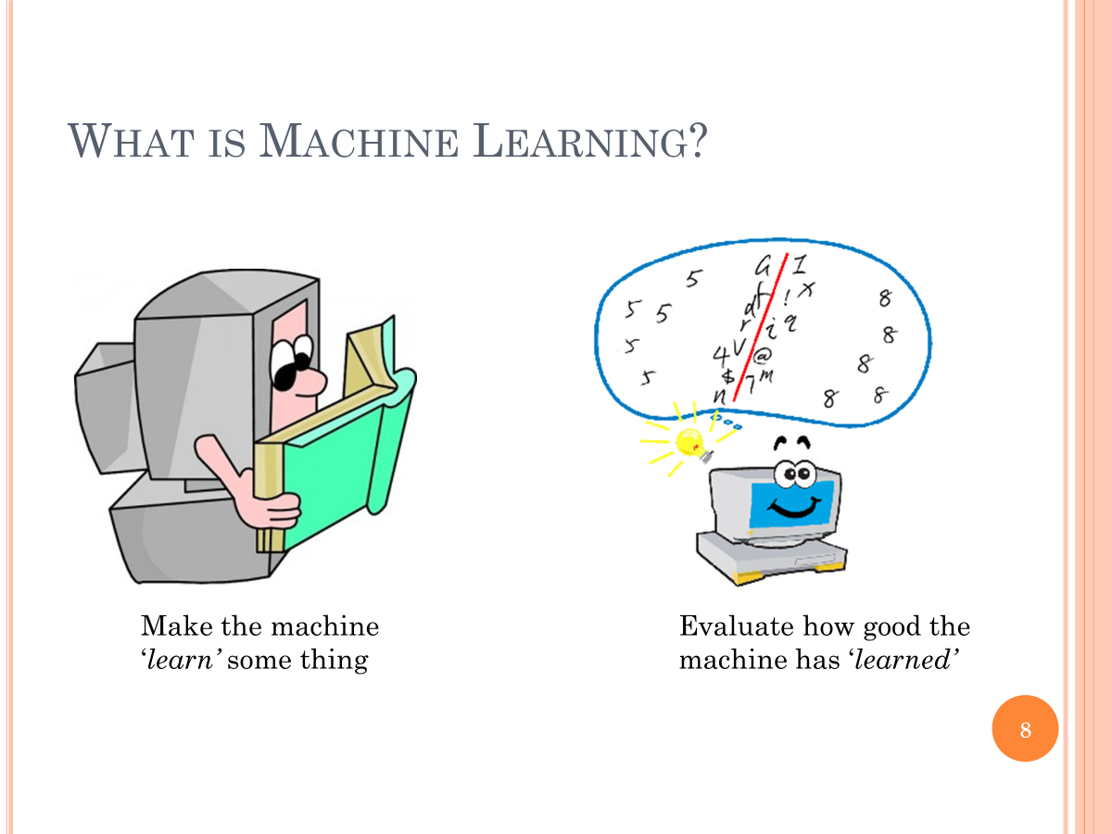
What is ML?

Slide 8
Machine Learning
Field of study that gives computers the ability to learn without being explicitly programmed.
Arthur Sameul (1959)

Slide 9

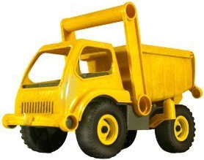
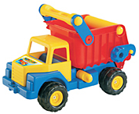
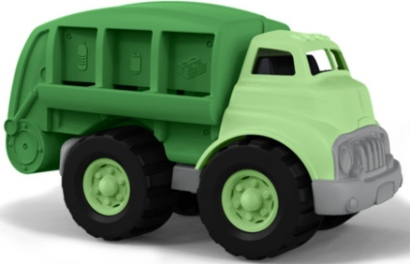
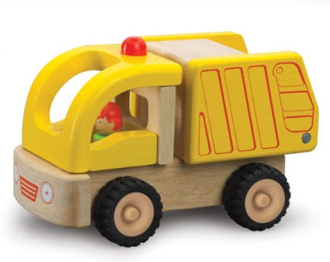
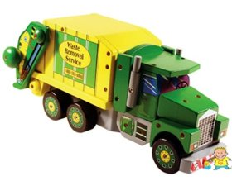
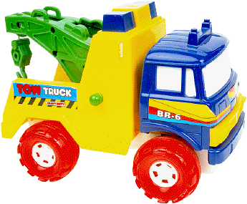
Machine Learning
Nicolas learns about trucks and dumpers

Slide 10

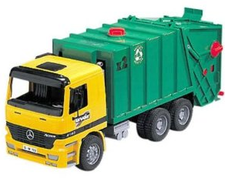
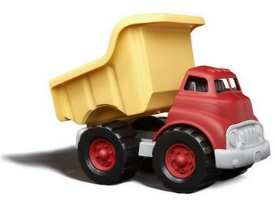
Machine learning
But will he recognize others?
So learning involves ability to generalize from labeled examples

Slide 11
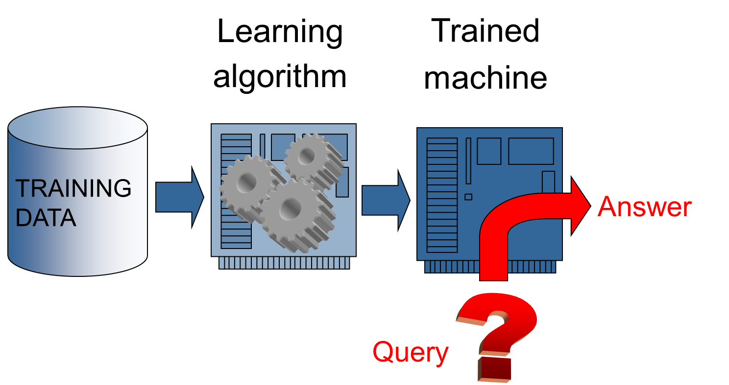
Machine learning

Slide 12
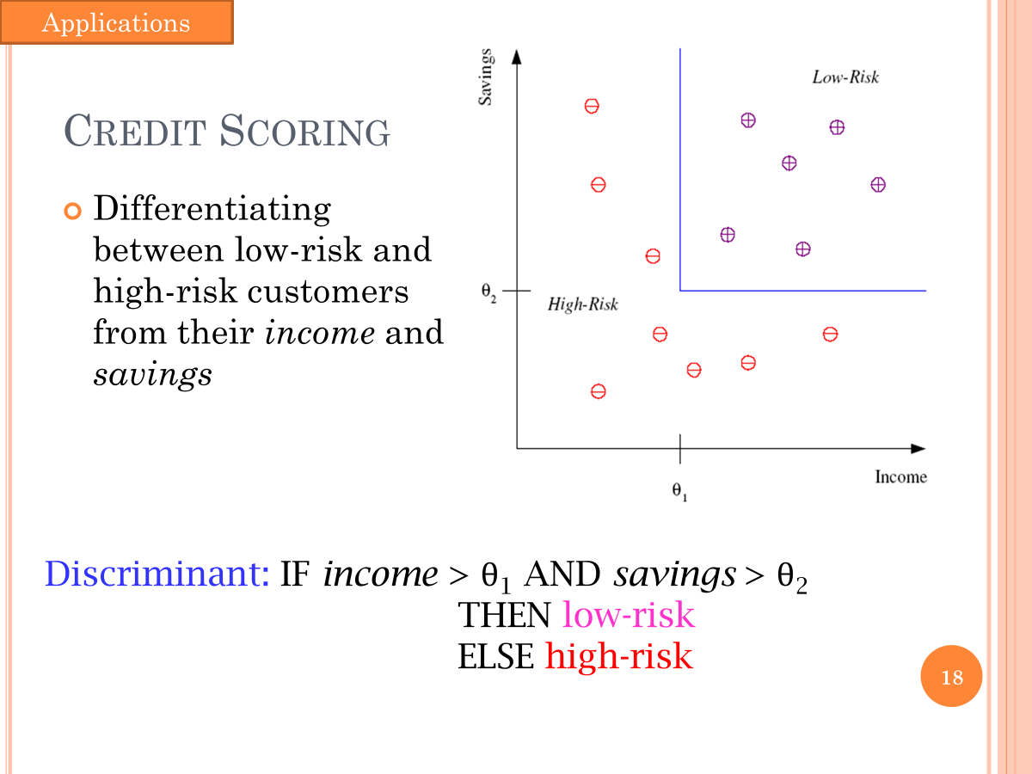

Slide 13
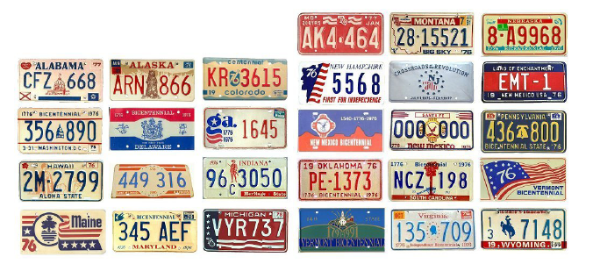
License Plate Recognition

Slide 14
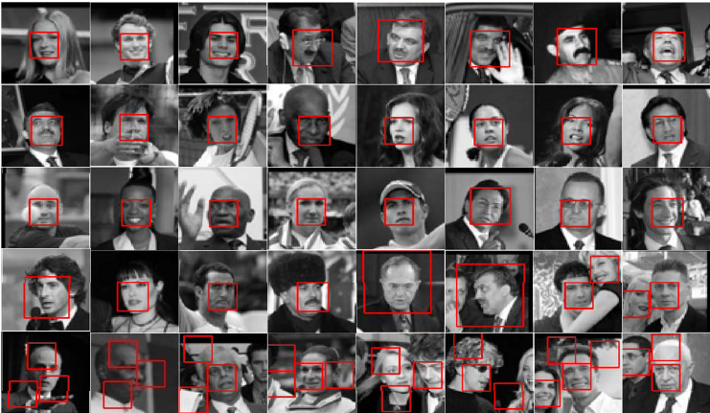
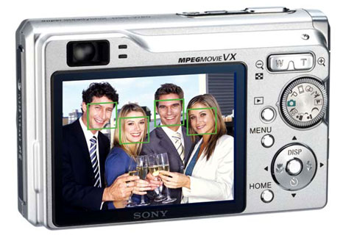
Face Detection

Slide 15
CLASSIFICATION

Slide 16
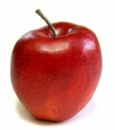
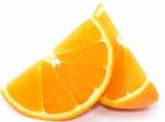
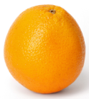

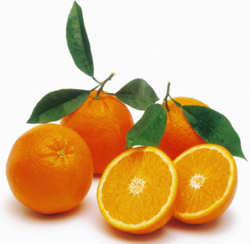
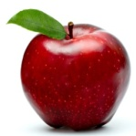
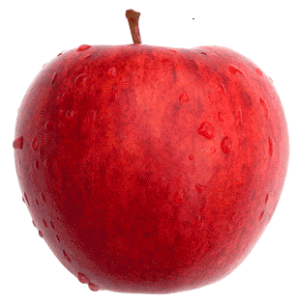
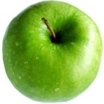
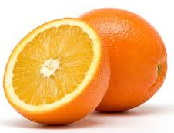
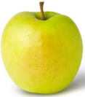
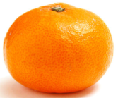
Supervised learning - Classification
Objective
Make a 2 year old kid recognize what is an apple and what is an orange
Strategy: Show some examples of each category
Apples
Oranges

Slide 17
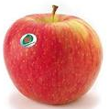


Classification
You had some training example or ‘training data’
The examples were ‘labeled’
You used those examples to make the kid ‘learn’ the difference between an apple and an orange
What is this???
Its an apple!!!

Slide 18
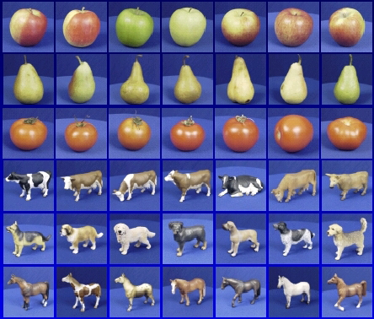

Classification
Apple
Pear
Tomato
Cow
Dog
Horse
Given: training images and their categories
What are the categories of these test images?

